Slide 1
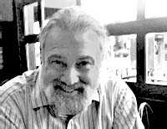
David Chaum
History of Cryptographer
Born 1955
Education UC - Berkeley

Slide 2

Digicash
Founded in 1989 by David Chaum
Pioneered the field of Digital cash transactions
Utilized digital signatures to ensure that peer to peer encryption is kept safe and secure

Slide 3
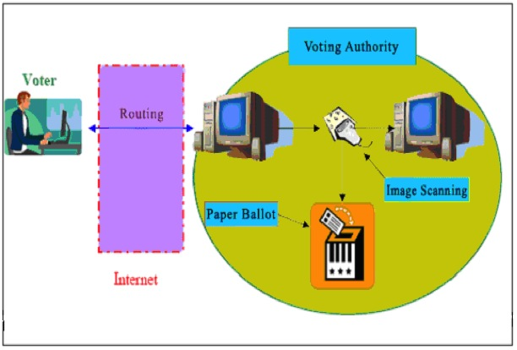
Notable Contributions to Digicash - Cryptography
Blind Signature - a form of digital signature in which the content of a message is disguised, or blinded, before it is signed. The resulting blind signature can be publicly verified against the original, unblinded message in the manner of a regular digital signature.
  Usages: This form of Cryptographic verification is used in voting systems as well as digital cash schemes.

Slide 4
Notable Contributions - Undeniable Signature
Undeniable Signature - a digital signature scheme which allows the signer to be selective to whom they allow to verify signatures. In this scheme, a signer possessing a private key can publish a signature of a message. However, the signature reveals nothing to a recipient/verifier of the message and signature without taking part in either of two interactive protocols:
  Confirmation protocol - confirms that a candidate is a valid signatory of the message issued by the signer. This is identified by the public key.
  Disavowal protocol - confirms that a candidate is not a valid signatory of the message issued by the signer.

Slide 5
Notable Contributions - Group Signature
Group Signature - Allows a member of a group to anonymously sign a message on behalf of the entire group. However, an appointed group manager holds the power to revoke the anonymity of any signer in the case of disputes.
  Examples - A group signature scheme could be used by an employee of a large company where it is sufficient for a verifier to know that a message was signed by an employee, but not which particular employee signed it.

Slide 6
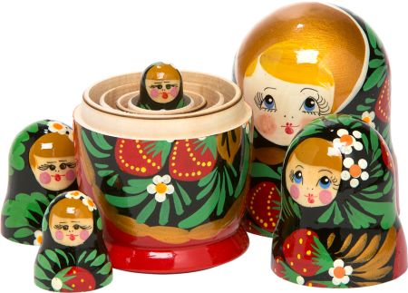
Notable Contributions - Anonymous Communications
Mix Networks - Create hard-to-trace communications by using a chain of proxy servers known as mixes which take in messages from multiple senders, shuffle them, and send them back out in random order to either the destination, or possibly another mix node. This breaks the link between the source of the request and the destination, making it harder for eavesdroppers to trace end-to-end communications.
Each message is encrypted to each proxy using public key cryptography; the resulting encryption is layered like a Russian doll
Applications that are based on this concept include: Tor onion routing and Mixmaster (anonymous remailer)

Slide 7
Notable Contributions - Voting Systems
In 1994, Chaum introduced the first in-person voting system in which voters cast ballots electronically at a polling station and cryptographically verify that the DRE did not modify their vote or even learn what it was.
Chaum proposed a series a cryptographically verifiable voting systems that use conventional paper ballots. One of the systems named Scantegrity was used in the November, 2009 elections in Takoma Park, Maryland. This was the first time a public sector election was run using cryptographically verifiable information.

Slide 8
Thank You!
Sources: Wikipedia, Chaum.org, Coindesk.com

